Slide 1

From Conception to Production – Planning Out Your Next Big Idea
Derek Mulhausen

Slide 2



Agenda
Example of what not to do
Principles of Lean Startup
Protecting your idea(or not)
Knowing Your Customer
Minimum Viable Product(MVP)

Slide 3

The way to get started is to quit talking and begin doing.
Walt Disney

Slide 4

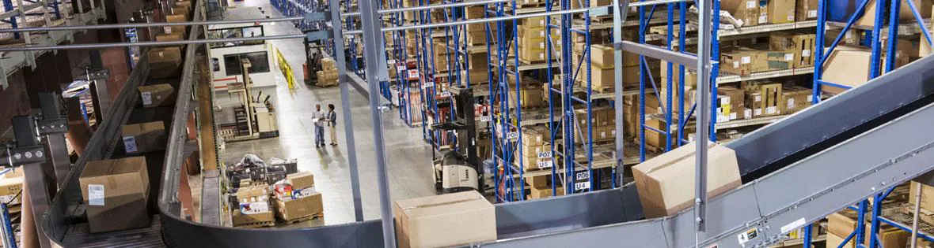
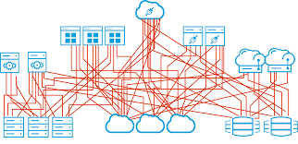
Example of what not to do.
Founded December 1996
Sought to overhaul the grocery business
Very well funded
Notes:
Overview
Founded December 1996
Goal was to set the rules for the largest consumer sector in the economy
Majority of the customers liked the business
Raised 800 million in funding
Built custom software and warehouse automation from the ground up
Beta tested in May 1999 with 40 million dollar distribution center
Goal was to expand to 26 cities by 2001
Valued at 4.8 billion
Traditional route
Followed business plan to the letter
Launched on the committed date because it lined up with marketing and that was the plan
Mistakes
Did not watch cash burn
Did not look at milestones to stop and evaluate launch results
Failure
Bankrupt June 2001
Layed off 2000 employees
Non-perishable food donated to local food banks
Followed get big fast and first mover advantage
Didn’t do customer research
Didn’t follow projected sales against actual sales
Contracted to expand without having the sales to support it
Bankrupt in 2001 after 3 years of operation
Lost 800 million

Slide 5
9 deadly sins Start Ups make when introducing a new product
Assuming “I know what the customer wants”
The “I know what features to build” flaw
Focus on Launch Date
Emphasis on execution instead of hypotheses, testing, learning, and iteration
Traditional business plans presume no trial and no error
Confusing traditional job titles with what a Startup needs to accomplish
Sales and marketing execute to a plan
Presumption of success leads to premature scaling
Management by crisis leads to a death spiral
https://www.linkedin.com/pulse/9-deadly-sins-start-ups-make-when-introducing-new-product-elaha-rafie/
Notes:
Assuming ''I know what the customer wants''
A lot of Startups try to apply an existing business model to their own company but fail to realize that on Day One, a Startup is a faith-based initiative built on guesses. It has no customers, and unless the founder is a true domain expert, he or she can only guess about the customer, problem, and business model. Yet a lot of founders take a traditional product introduction methodology and apply it on their own business.
In my case, I also struggled and still struggle with this problem and was desperately looking for a right business model or strategy but decided to stay as flexible as possible in order to be able to change fast. As Steve Blank and Bob Dorf explain: ''To succeed, founders need to turn hypotheses or guesses into facts as soon as possible by getting out of the building, asking customers if the hypotheses were correct, and quickly changing those that were wrong''.
2. The ''I know what features to build'' flaw
At the end the customer is always right, and assuming you know what the customer wants and needs can be a huge risk. Some founders ask themselves why their product failed while they were designing, and building a fully featured product using classic product development methods without ever leaving their building. Without direct and continuous customer contact, it's unknown whether the features appeal to customers. Fixing the product mistakes after building and shipping the entire product is costly and time consuming, if not deadly. Therefore as a Startup you need to be in contact with your customers from day one and constantly ask them for feedback.
In my case I sent several prototype backpacks to potential customers. The feedback we received every time was of incredible value. Based on that feedback we modified the product every time and we are still in the process of testing and modifying before we start selling. The bottom line here is that you should not be afraid to fail your way to a great product. Receiving negative feedback from your potential customers in this stage is crucial and necessary in order to avoid negative feedback once you start shipping.
3. Focus on Launch Date
Time after time, only after launch does a Startup discover that not enough customers visit its website, play the game, convert to orders or they discover that the product doesn't solve a high-value problem. These Startups usually focus on traditional product introduction models where every department is focused on launch date and work towards that date. Neither management nor investors tolerate wrong turns that result in delays. Obviously every Startup or company wants to get to market and sell it, but that can't be done until the company understands who it's selling to and why they'll buy.
For me this has been a very stressful factor, I have set a launch date 3 times in a row and decided to postpone it every time because the product or website was simply not ready yet. Right now we are almost finished with the preparations of the first Crowd funding campaign.
4. Emphasis on execution instead of hypotheses, testing, learning, and iteration
While established companies execute business models where customers, problems, and necessary product features are all known, Startups need to operate in a ''search'' mode as they test and prove every one of their initial hypotheses. They learn from the results of each test, refine the hypothesis and test again, all in search of a repeatable, scalable and profitable business model. The ability to learn from missteps distinguishes a successful Startup.
5. Traditional business plans presume no trial and no error
Instead of asking ''How many days to the launch date? or ''What's in our sales pipeline? a Startup's board and management team need to ask specific questions about results of its long list of tests and experiments to validate all components of its business model. If these questions aren't asked, time is wasted.
6. Confusing traditional job titles with what a Startup needs to accomplish
The title Sales in an existing company reflects a team repeatedly selling a known product to a well-understood group of customers with standard presentations, prices, terms and conditions. Startups by definition have few if any of these known elements. In fact, they're out searching them! The demands of customer discovery require people who are comfortable with change, chaos, and learning from failure and are at ease working in risky unstable situations without a roadmap.
7. Sales and marketing execute to a plan
Hiring VPs and execs with the right titles but the wrong skills leads to further Startup trouble, because they will follow the traditional business plan and product introduction model and measure progress against ''the plan''. But the hypotheses in the business plan aren't tested yet, so you need to be flexible for changes and work in a fast changing environment. In a majority of Startups, measuring progress against a product launch or revenue plan is simply false progress, since it transpires in a vacuum absent real customer feedback, instead of searching for an understanding of customers and their problems and replacing assumptions with facts.
8. Presumption of success leads to premature scaling
The business plan, its revenue forecast, and the product introduction model assume that every step a Startup takes proceeds flawlessly and smoothly to the next. The model leaves little room for error, learning or customer feedback. Nothing says, ''Stop or slow down hiring until you understand customers''. This leads to premature scaling. Hiring and spending should accelerate only after sales and marketing have become predictable, repeatable and scalable processes - not when the plan says they're scheduled to begin.
9. Management by crisis leads to a death spiral
When Startups made all the above mentioned mistakes it will find itself in a crisis by the time of their first customer shipment and they realize they were completely wrong about their sales forecast. The problem here is not always an incorrect sales strategy or positioning. The problem is that no business plan survives first contact with customers. And when you've burned a lot of money on the wrong strategy because you don't know your customers well enough, it can lead to the end of your company.
As a learning entrepreneur myself, I don't know if all the steps I am taking right now, in order to create one of the best Smart Travel Backpacks out there, are the right steps.

Slide 6
5 Principles of a Lean Startup
Entrepreneurs are everywhere
Entrepreneurship is management
Validated learning
Innovation Accounting
Build-Measure-Learn
Notes:
1. Entrepreneurs are everywhere
There are many types of entrepreneurs and startups. Tons of opportunities exist that entrepreneurs can take advantage of to build a successful business.
2. Entrepreneurship is management
Startups need management just like any company. However, lean startups have a unique type. Having flexible, learning oriented management makes for a successful lean startup.
3. Validated learning
Lean startups primarily serve customers with their products. They adapt to the needs of the target market by learning exactly what it is that customers want. Through experimentation, they find what works best.
4. Innovation Accounting
Lean startups keep detailed records of tests and analysis to figure out what works best. They gauge progress on the amount learned about the innovation rather than the amount of new work created.
5. Build-Measure-Learn
Lean startups hit the ground running by building the simplest product that does what it should, called the Minimum Viable Product (MVP). This goes through rigorous evaluation through tests and user feedback to collect data on how targeted users accept the product. If it works, then they learn from the feedback and make it better in an iterative process.

Slide 7
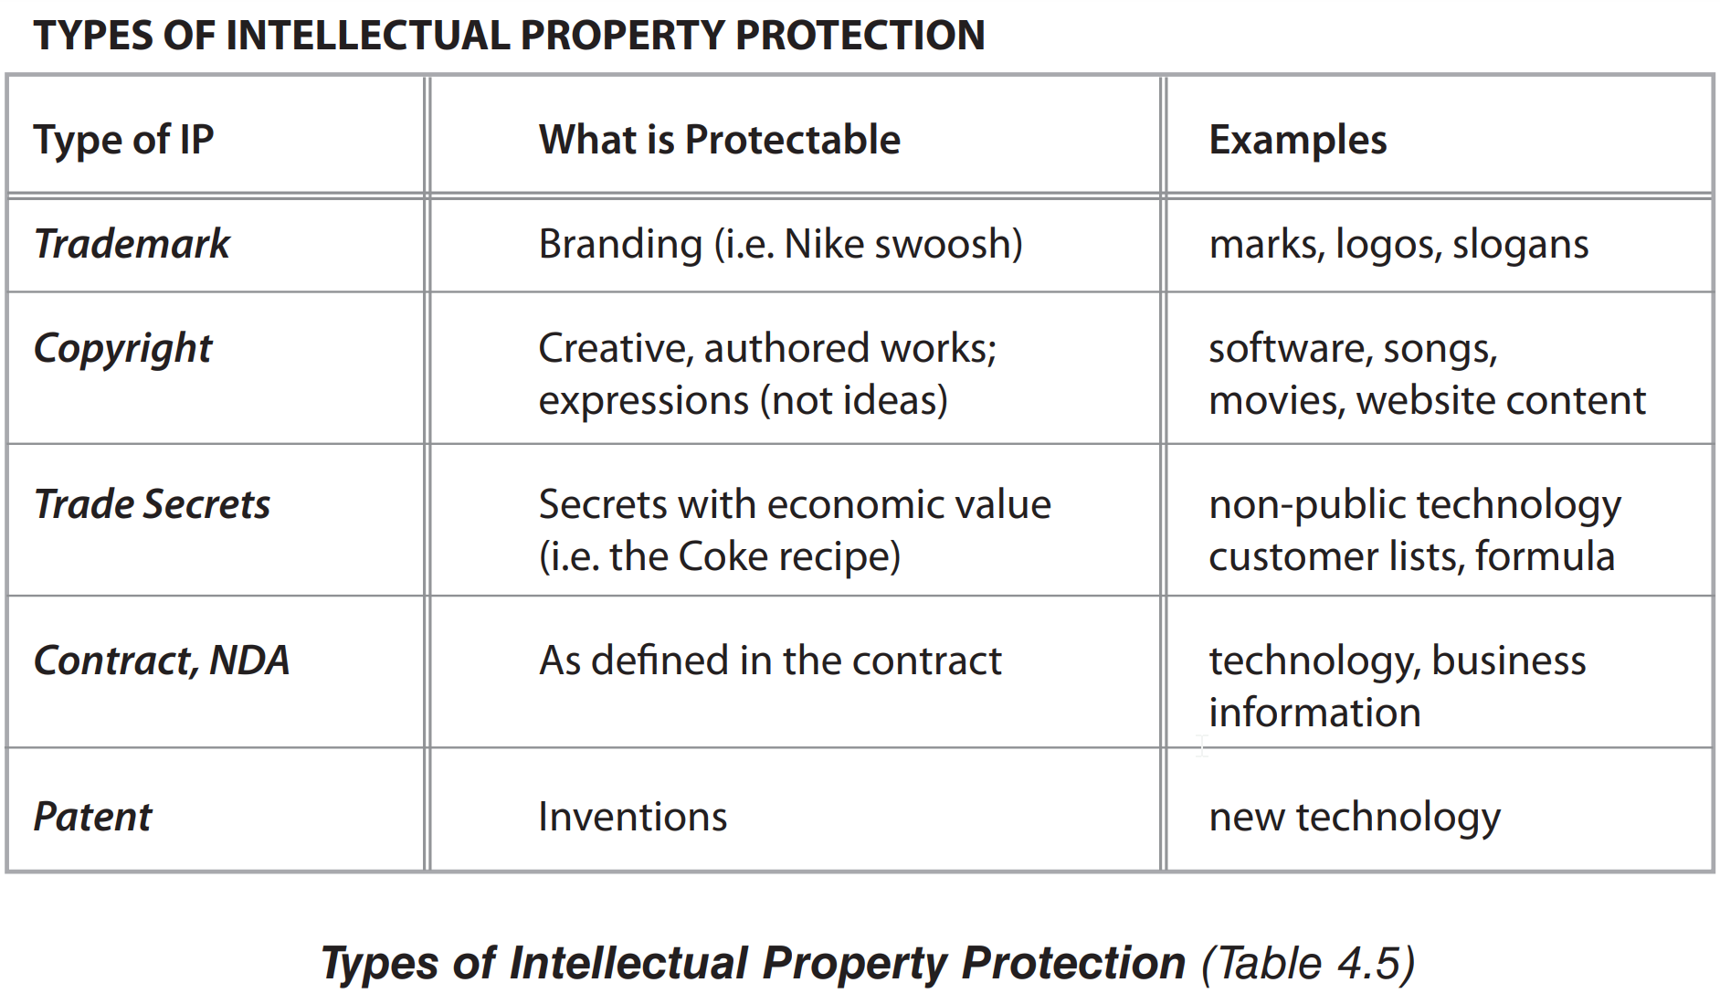
Intellectual Property Protection
Notes:
Patent is 20-50k

Slide 8

Know Your Customer
Seek first to understand, then to be understood.
--Stephen Covey

Slide 9

Research
Get to know your customers
Follow thought leaders
Subscribe to industry periodicals
Go to conferences
Notes:
Get to know your customers
How do they spend their day?
15 minute chunks
What do they read?
Look for common threads of potential customers for what and who they follow on social media sites
Go to conferences
Example of Jeff

Slide 10

Setting up Interviews
General guidelines
Targets
On success
On refusal
Example
Notes:
General guidelines
Ask for 15 minutes. The person will normally provide more
Be professional
Do not sound apologetic
Record yourself leaving the message
Be transparent
Try calling just before working day or at the conclusion of the day to catch the target
Be careful not to follow a script
Best to get introductions through peers
Better to avoid decision makers during discovery
Targets
5-10 / 50
Target 50 initial interviewees
Eventually target >=10/day
On success
Ask to record or to bring a notetaker
On refusal
Ask for a referral
“Thank you for your time. Is there anybody else you can recommend to speak to on this topic?
Example
Dr. Jones
Referred by Sally Smith
Veterinary scheduling software
15 minutes of your time

Slide 11
Doing the Interview
Keep it conversational
Don’t sell
Record(with permission)
Seek to understand
Notes:
How would you describe the industry in which your company does business?
What is your job role? Your title?
How long have you had this role and title?
How is your job measured? Do you have numbers you’re responsible for?
What do you worry about when it comes to "hitting your numbers?"
What does a typical day look like?
What do you do when you're most productive?
Are you spending more time at work or at home?
Where would you rather be?
If you were hiring someone to replace you and had to write a job description of what's actually required, what would it say?
What are your biggest challenges?
What does it mean to be successful in your role?
How do you learn about new information for your job? How do you stay informed?
If you're online learners, do you visit social networks? Do you use Google?
Which publications or blogs do you read?
How do you prefer to interact with vendors? (email, phone, in person)
Describe a recent purchase.
Why did you consider a purchase? What was the evaluation process?
How did you decide to purchase that product or service?
What might make you reticent to buy from a provider in your industry?

Slide 12
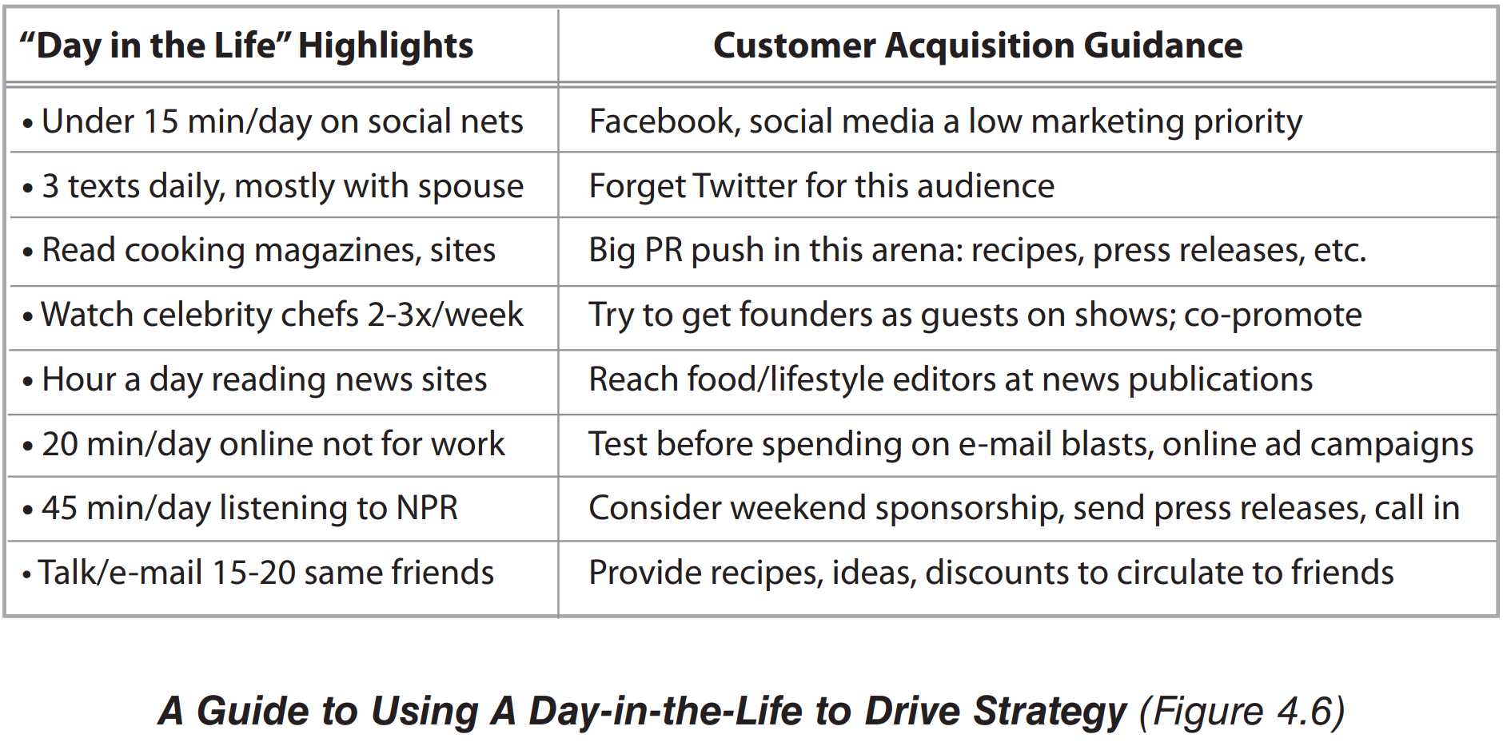
Day in the life analysis

Slide 13
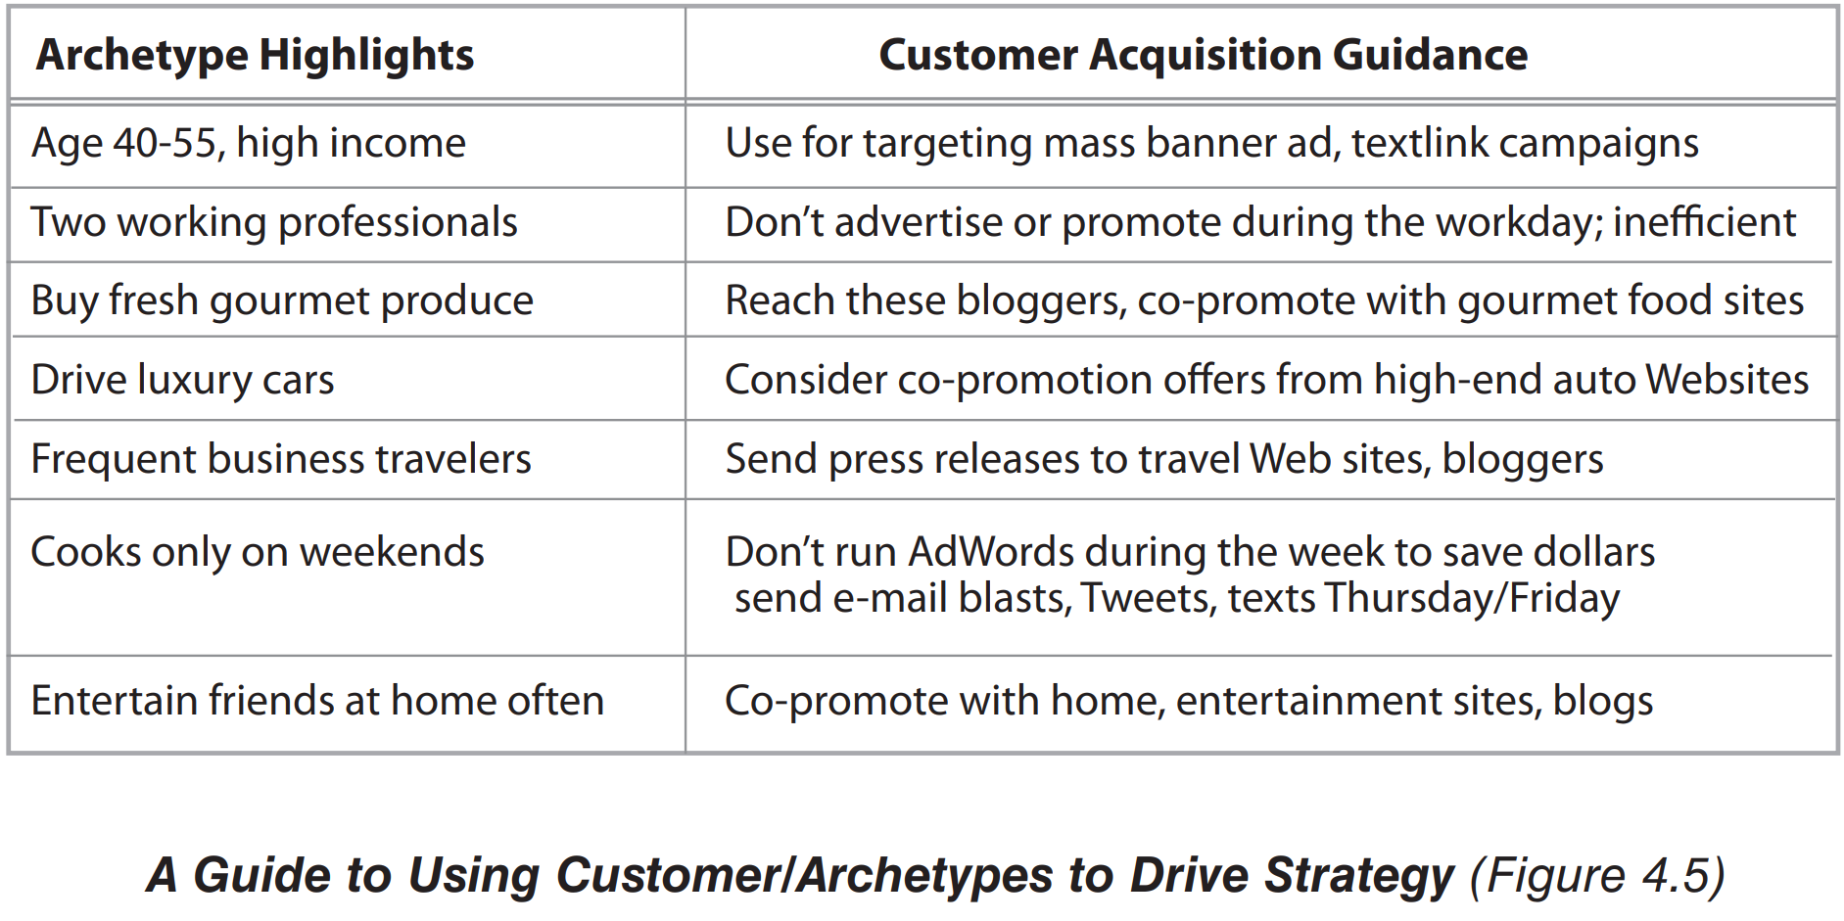
Archetype analysis example

Slide 14
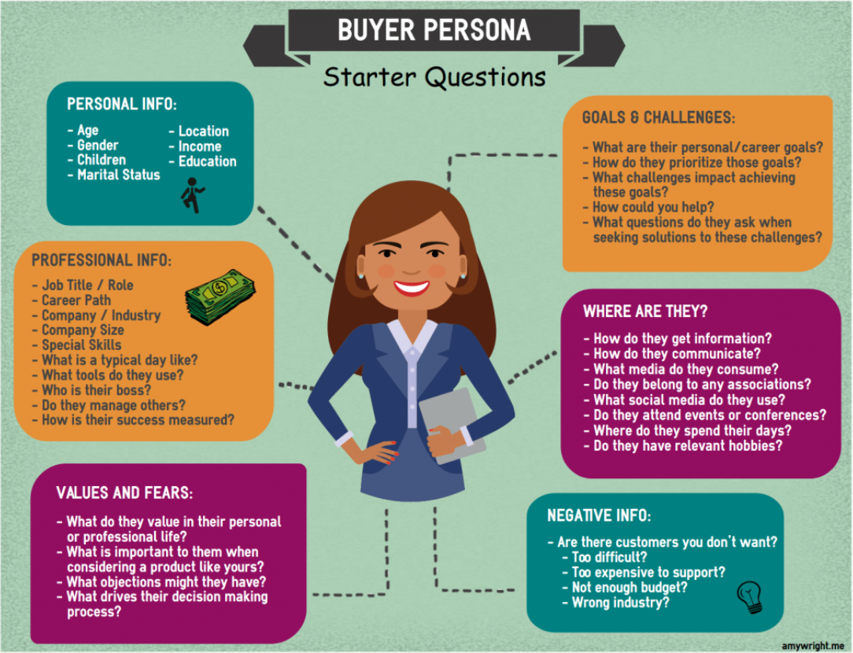
Persona Demographics

Slide 15
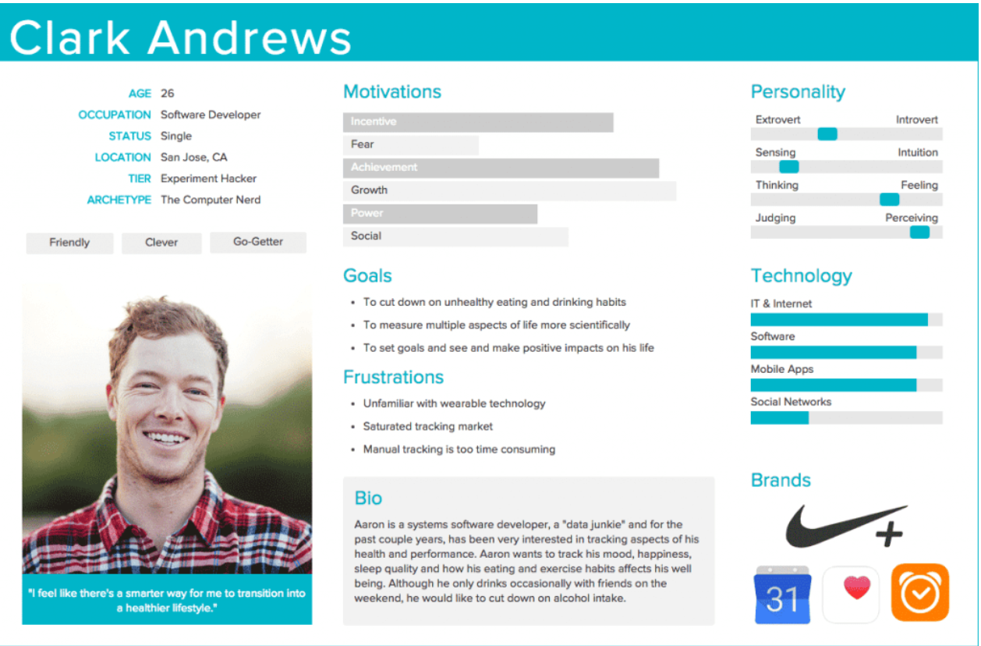
Persona Example
https://xd.adobe.com/ideas/process/user-research/putting-personas-to-work-in-ux-design/
Notes:
Personas were born
1983
Software Developer Alan Cooper
Created the persona of Kathy
Software technically oriented at the time but wanted to create software for users
Allowed him to see what was necessary and unnecessary
Saw what was used frequently and infrequently
Allowed discussions of what each persona would do when talking to programmers

Slide 16
Minimum Viable Product(MVP)
An early, basic version of a product that meets the minimum necessary requirements for use but can be adapted and improved in the future, especially after customer feedback
--Oxford Languages Dictionary

Slide 17
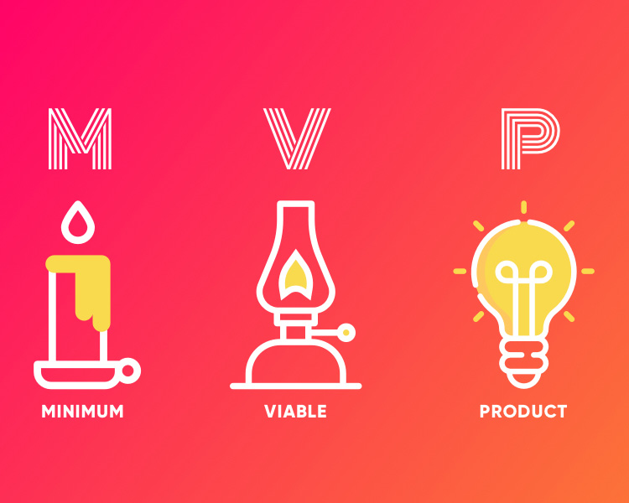
MVP Types
The fake door MVP
Landing page MVP
Email campaign MVP
Marketing campaign MVP
Pre-order MVP
Single-feature App MVP
Piecemeal MVP
Concierge MVP
Wizard of Oz MVP
Notes:
Fake door – no actual app, product, or service. Like a landing page, but people normally see coming soon or work in progress since there is no product. Example of Dropbox where the fake door measured interest before the product was developed.
Landing page MVP – Similar to fake door, but asks users to join a waiting list.
Email campaign – similar to fake door but asks to send visitors an email of the idea
Marketing – combines the first 3 with the addition of marketing
Pre-order MVP – Type of marketing MVP that asks users to order the product in advance. GoFundMe and Kickstarter are examples of this
Single-feature App MVP – covers only one core feature. This is what most picture when they think of MVPs
Piecemeal MVP – uses third party tools instead of building from scratch.
Development is faster and cheaper
Concierge MVP – backend is run manually by people.
Food on the table is one example where founders visited one person initially weekly and got to know them very well
9.95 was collected each week.
Automation was created when the founder treatment became unsustainable
Wizard of Oz MVP
Pay no attention to the man behind the curtain
Users are unaware that the backend is done by people instead of by automation
Amazon used this method where somebody would order a book and then it was purchased and sent manually

Slide 18
Resources
The Lean Startup by Eric Ries
The Startup Owner’s Manual by Steve Blank and Bob Dorf
Buyer Personas by Adele Revella

Slide 19
Questions?

Slide 20



Thank You
Derek Mulhausen
derek-mulhausen
Derek.Mulhausen@hotmail.com
https://github.com/DerekMulhausen/from-conception-to-production.git

